Slide 1
IMDB MOVIE ANALYSIS
ANSU M CHIRAYIL
Hyperlink to the Excel Sheet: https://docs.google.com/spreadsheets/d/1gk6UUV4lWIbcUrEnm_8l5-1lkl2pXqnS/edit?usp=sharing&ouid=102355042022057054818&rtpof=true&sd=true/
Hyperlink to iPython Notebook: https://drive.google.com/file/d/14mlC-gM7abt6czYpvAMFhCc6-xcDxw8p/view?usp=sharing/

Slide 2
PROJECT DESCRIPTION
Project Objective: Provide insights into the factors influencing the success of movies, defined by their IMDB scores, using a dataset with details about movies.
Target Audience: Filmmakers and stakeholders who need actionable insights to guide movie production and decision-making.
Data Analysis Approach: Utilize Python for data preprocessing, including cleaning and preparing the dataset. Use Microsoft Excel for data extraction, filtering, and detailed analysis to derive insights.
Analytical Tasks: Analyse relationships between IMDB scores and various movie attributes (e.g., genre, budget, release year). Address specific queries using the pre-processed data to uncover patterns and trends.
Expected Outcomes: Deliver actionable insights and recommendations based on the analysis to help filmmakers and stakeholders understand what contributes to a movie's success.

Slide 3
APPROACH
1. Understanding the Dataset: Begin by thoroughly exploring the dataset to understand its structure and contents. Review columns such as director name, actor names, genres, plot keywords, budget, gross collection, and IMDB score.
2. Data Pre-Processing:
Handle Missing Data: Identify and address any missing values through imputation or removal, depending on the extent and impact.
Correct Data Errors: Check for and correct any data entry errors or inconsistencies.
Manage Outliers: Detect and handle outliers to ensure they do not skew the analysis.
Remove Duplicates: Eliminate any duplicate records to avoid redundancy.

Slide 4
APPROACH
3. Data Filtering and Analysis:
Filter the data according to specific queries or criteria relevant to the analysis.
Use Microsoft Excel to extract and refine the data further.
Create visualizations (graphs, charts) to aid in understanding patterns and relationships within the data.
4. Drawing Conclusions and Insights: Analyze the filtered data and visualizations to draw meaningful conclusions, identify key factors influencing IMDB scores and other success metrics, and summarize the insights in a clear and actionable format.
5. Reporting: Compile a comprehensive report summarizing the dataset analysis, findings, and insights, including visualizations to support the conclusions, and present it to the hiring department to aid in decision-making.

Slide 5
TECH-STACK USED
Python 3.12.0. - Programming language used for Data Pre-processing
Jupyter Notebook 7.0.0. - Interactive platform to write and execute codes in various programming languages (in this case Python).
Microsoft Excel 2021 - A spreadsheet editor software used mainly by professionals to enter data in table format, perform computations, plot graphs etc. Here Microsoft Excel is used to filter data and plot graphs to get insights about the movies

Slide 6

DATASET OVERVIEW
Dataset details:
Number of data points – 5043
Number of features – 28
Column details –
color: Whether movie is coloured or black and white
director_name: Name of the Director
num_critic_for_reviews: Number of critics that gave reviews for the movie
duration: Duration of the movie
director_facebook_likes: Number of Facebook likes the director has
actor_3_facebook_likes: Number of Facebook likes actor 3 has
actor_2_name: Name of actor 2
actor_1_facebook_likes: How many Facebook likes actor 1 has
gross: Gross collection of the movie
genres: Genres of the movie
actor_1_name: Name of actor 1
movie_title: Name of the movie
num_voted_users: Number of users voted for the movie

Slide 7
DATASET OVERVIEW
cast_total_facebook_likes: Number of Facebook likes the whole cast has together
actor_3_name: Name of actor 3
facenumber_in_poster: Number of faces in the movie poster
plot_keywords: Keywords of the movie plot
movie_imdb_link: Link to IMDB page of the movie
num_user_for_reviews: Number of users who gave review to the movie
language: Language of the movie
country: Country in which the movie was made
content_rating: The certificate that the movie got
budget: Budget of the movie
title_year: Release year of the movie
actor_2_facebook_likes: Number of Facebook likes actor 2 has
imdb_score: IMDB Score of the movie
aspect_ratio: The aspect ratio in which the movie was made
movie_facebook_likes: Number of Facebook likes the movie has

Slide 8
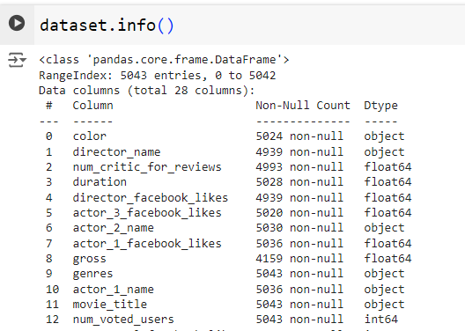
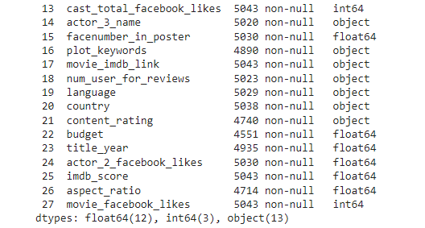
DATASET OVERVIEW

Slide 9
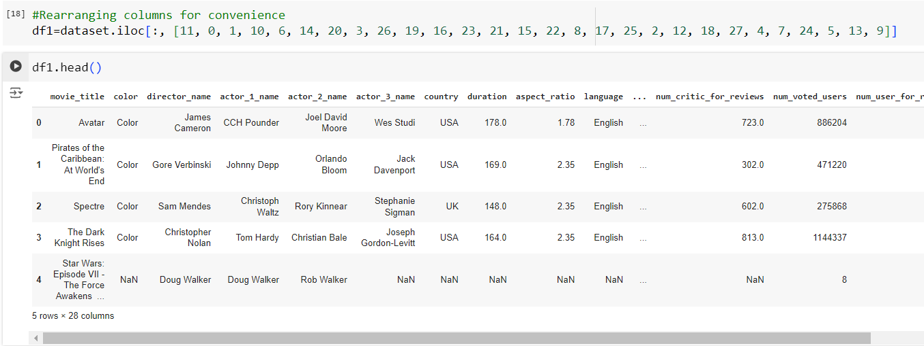
DATA PRE-PROCESSING
1. Rearranging columns for convenience

Slide 10
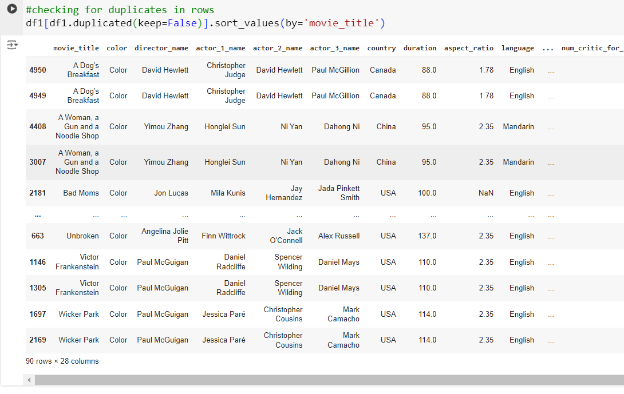

DATA PRE-PROCESSING
2. Checked for duplicates across all rows, found 90 duplicate entries, and retained one instance of each while removing the rest.
Removing Duplicates

Slide 11
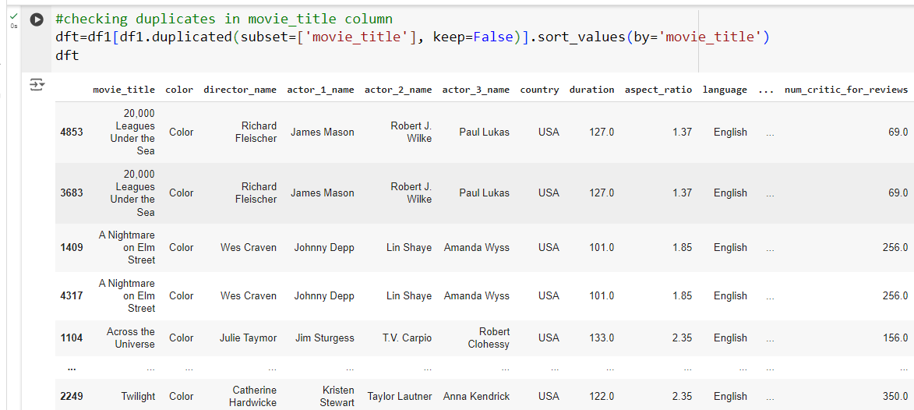
DATA PRE-PROCESSING
3a. Checking duplicates in movie_title column. Found 161 rows

Slide 12
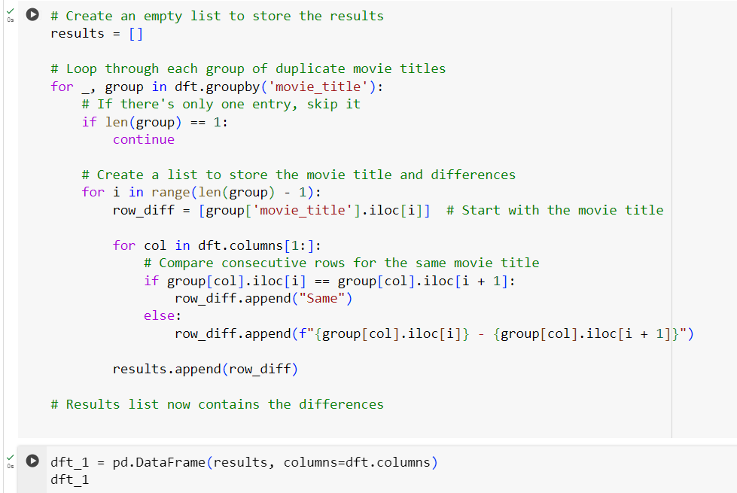
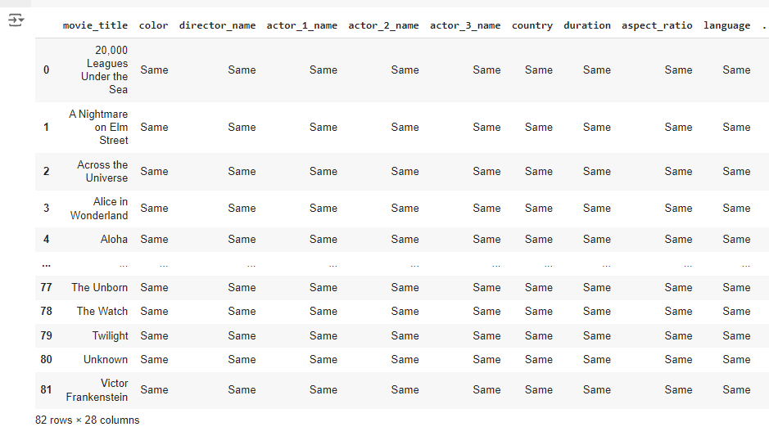
DATA PRE-PROCESSING
3b. Additionally, identify which column values differ for duplicate movie_title entries. Found 82 rows

Slide 13
DATA PRE-PROCESSING
3b. Based on the DataFrame above, we observed that, except for the movies "Out of the Blue" and "The Host," the differences between rows with the same `movie_title` are primarily in columns related to Facebook likes and "num_voted_users." Therefore, we can safely drop the duplicate rows, retaining just one copy of each, without significantly affecting the overall analysis.
We extracted only the rows with unique `movie_title` values, the first occurrence of each duplicate `movie_title`, and all duplicates for the movies "Out of the Blue" and "The Host."

Slide 14
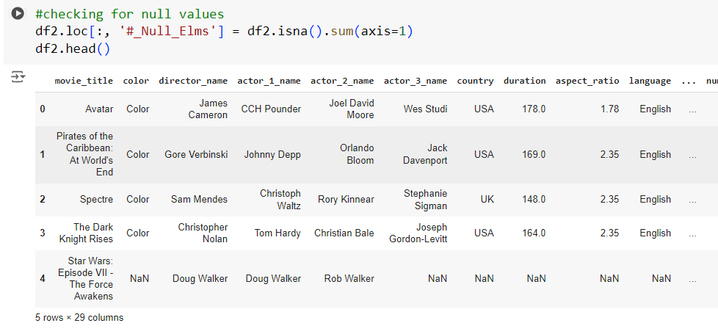
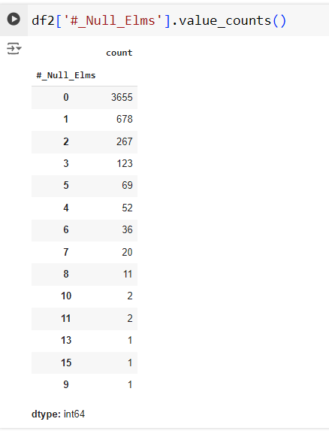

DATA PRE-PROCESSING
4. We checked for null values and analyzed their frequency on a row-by-row basis. We then dropped all rows with more than 9 null values.

Slide 15
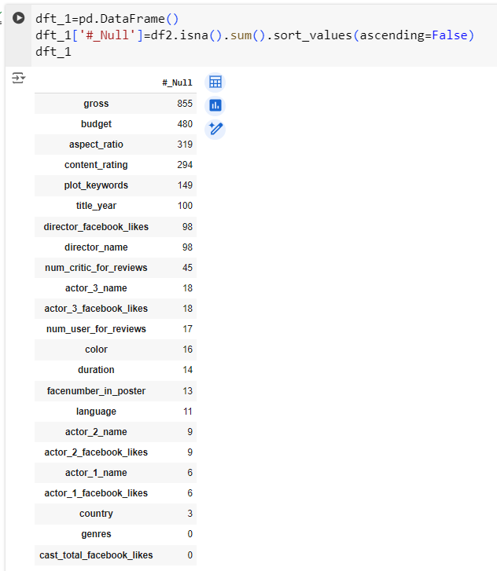
DATA PRE-PROCESSING
5. Checking for null values column wise

Slide 16
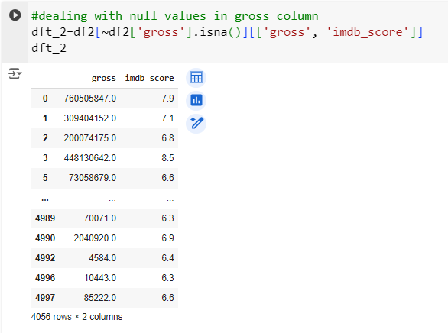
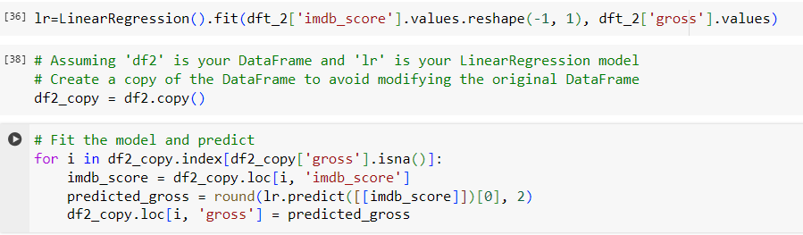
DATA PRE-PROCESSING
6. Dealing with Null values in gross column
Action : First, fit a Linear Regression model using imdb_score and gross. Then, predict the Gross value for the row with a null gross value based on the IMDB Score.

Slide 17
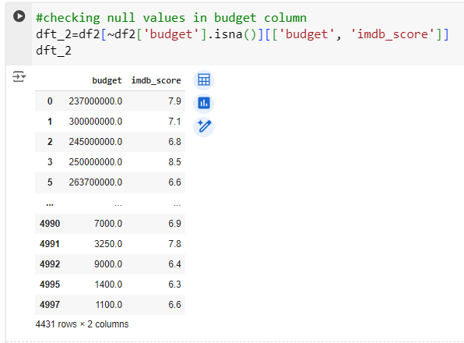
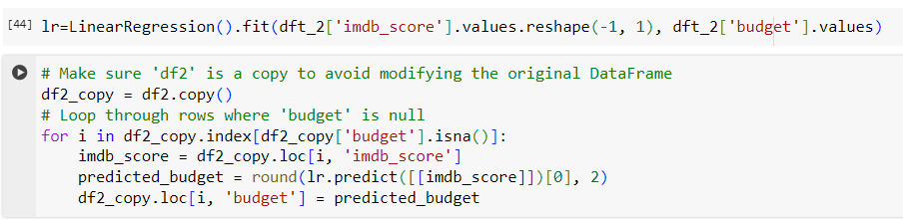
DATA PRE-PROCESSING
7. Handling null values in the budget column by fitting a Linear Regression model using imdb_score and budget, and then predicting the gross value for rows with a null budget based on the IMDB Score.

Slide 18
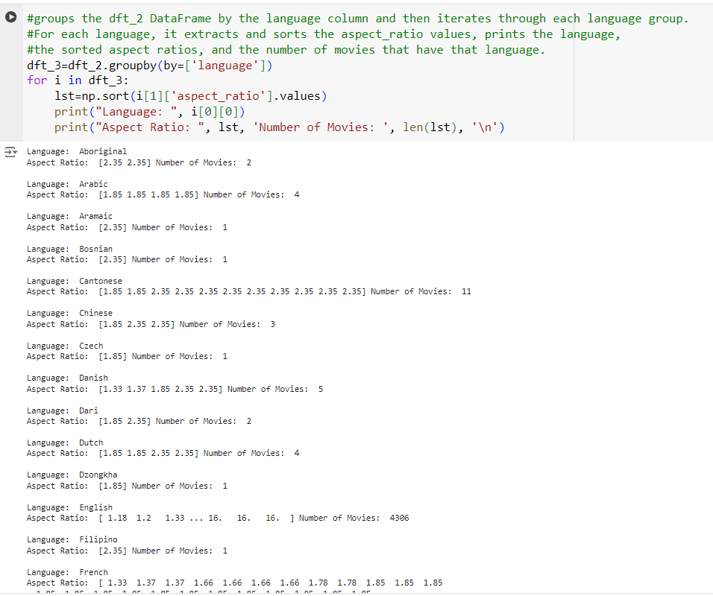
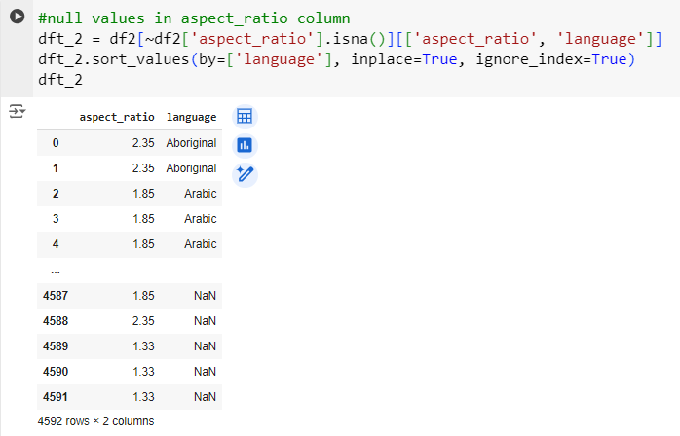
DATA PRE-PROCESSING
8a. Handling null values in the aspect_ratio column by first identifying the most frequent aspect_ratio for each language. Then, replacing the null values in aspect_ratio with the most frequent aspect_ratio corresponding to each row's language

Slide 19
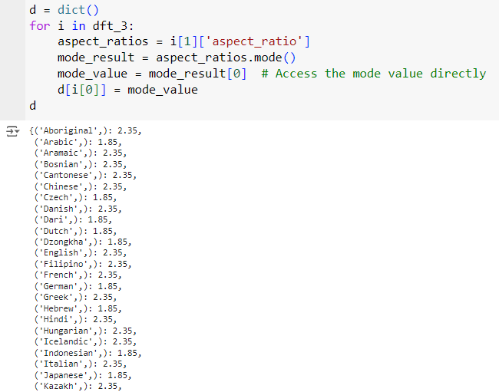
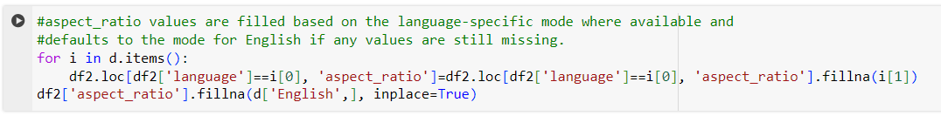
DATA PRE-PROCESSING
8b. Calculates the most frequent aspect_ratio (mode) for each language group in the DataFrame
and stores these values in a dictionary

Slide 20
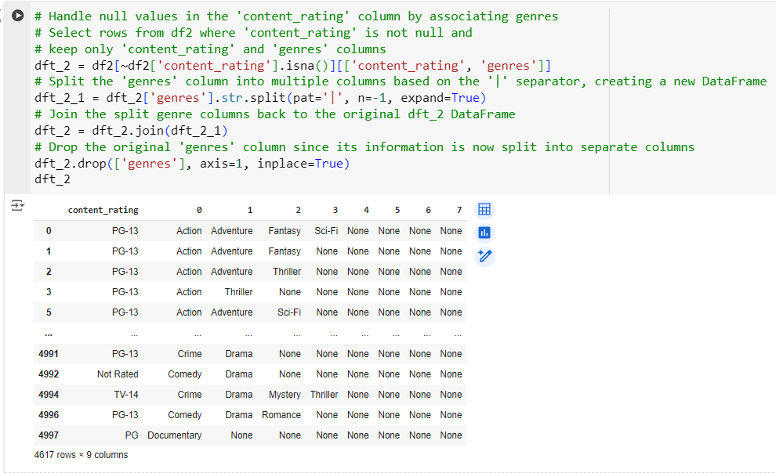
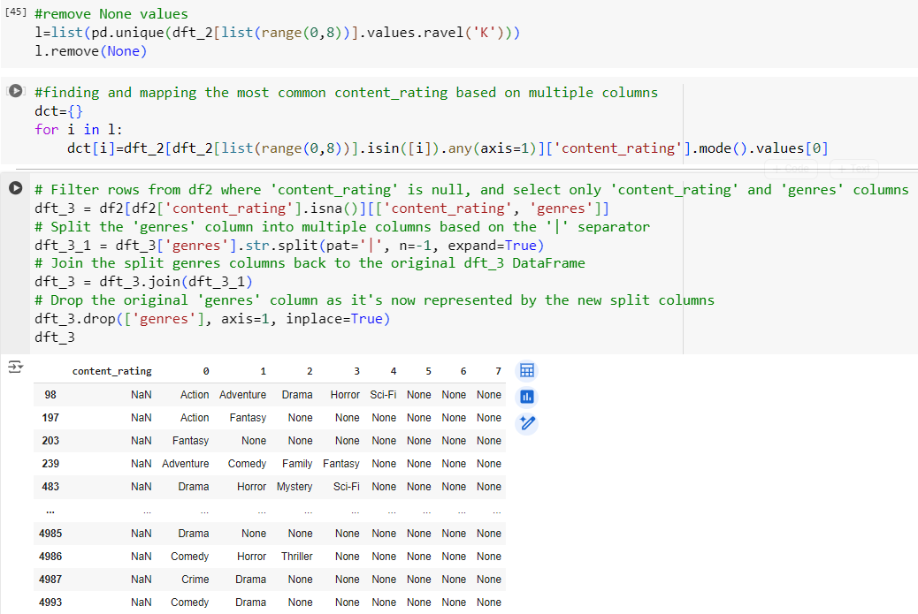
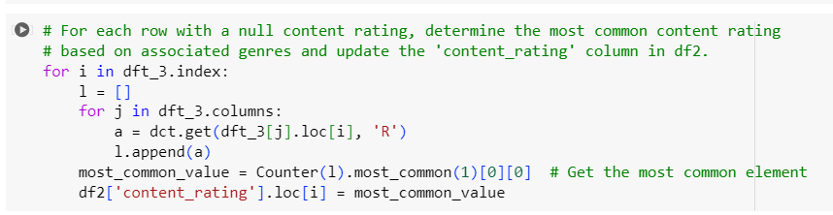
DATA PRE-PROCESSING
9. Handling null values in the content_rating column: We first identified the most frequent content_rating for each genre from rows without missing values. Then, for rows with null values in content_rating, we determined the most common content_rating within their respective genres and replaced the null values with this frequent rating.

Slide 21
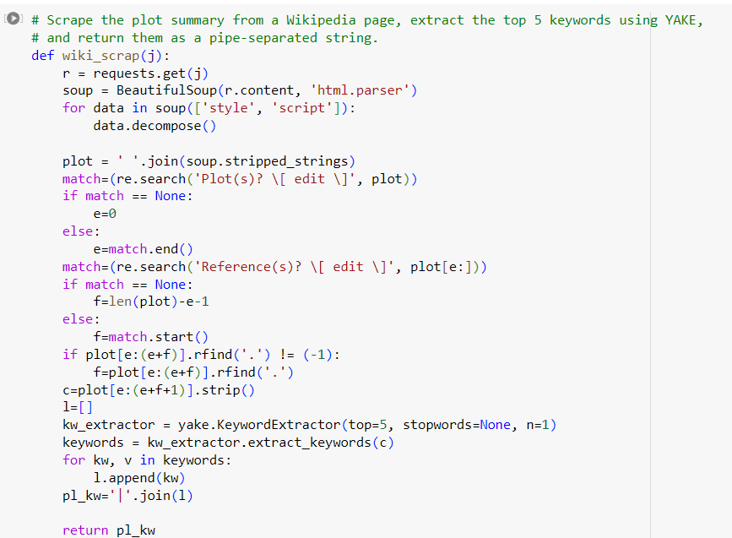
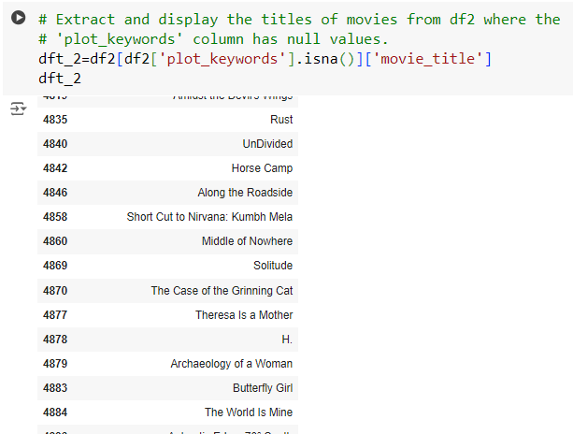
DATA PRE-PROCESSING
10. Handling null values in the plot_keywords column: For each movie in the DataFrame, we scraped the movie's Wikipedia page to retrieve a plot summary and then used the KeywordExtractor function from the yake library to extract the top 5 keywords.

Slide 22
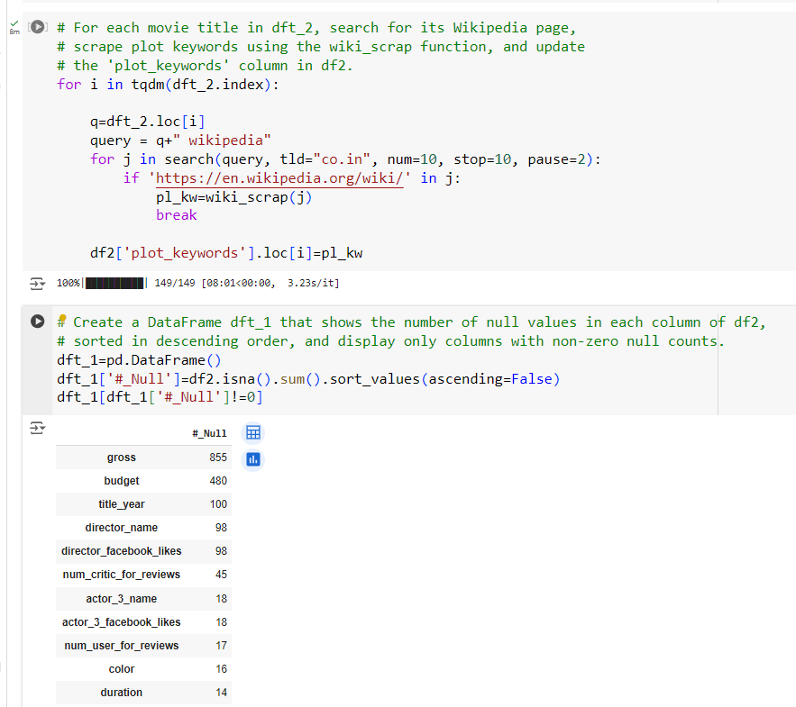
DATA PRE-PROCESSING
10. Handling null values in the plot_keywords column: For each movie in the DataFrame, we scraped the movie's Wikipedia page to retrieve a plot summary and then used the KeywordExtractor function from the yake library to extract the top 5 keywords.

Slide 23
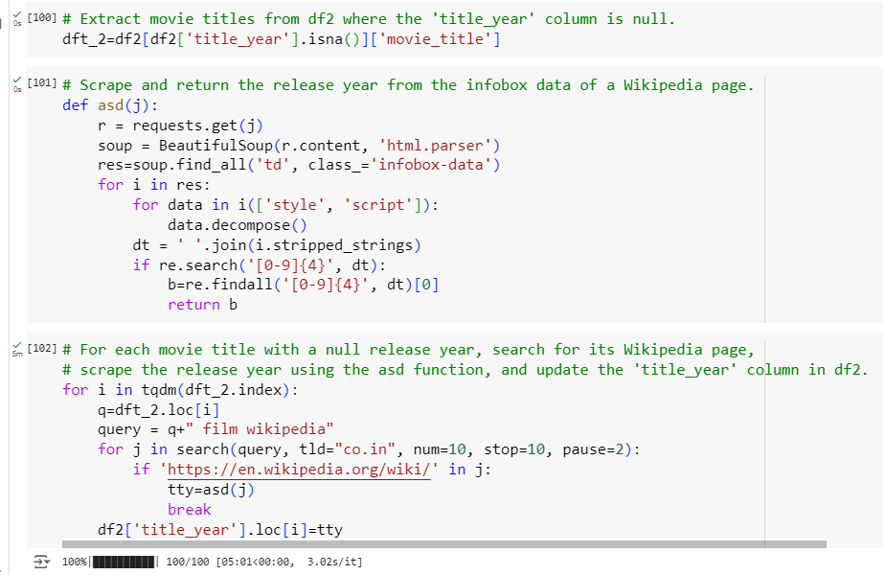
DATA PRE-PROCESSING
11a. Handling null values in the title_year column: For each movie with a null title_year in the DataFrame, we scraped the movie’s Wikipedia page to retrieve its release year and updated the original DataFrame with this information.

Slide 24
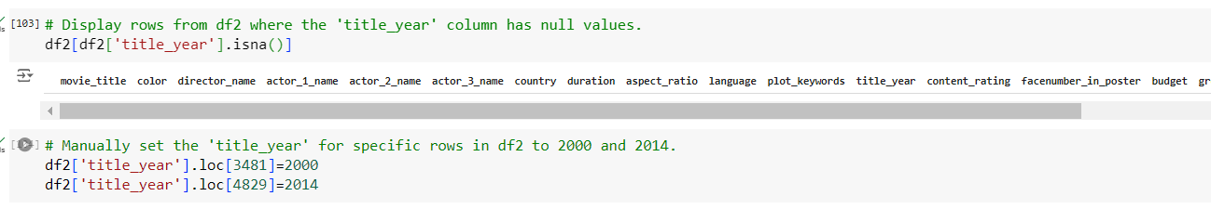
DATA PRE-PROCESSING
11b. Handling remaining null values in the title_year column, which were not addressed by the previous process: The title_year for these rows was manually filled by researching online.

Slide 25
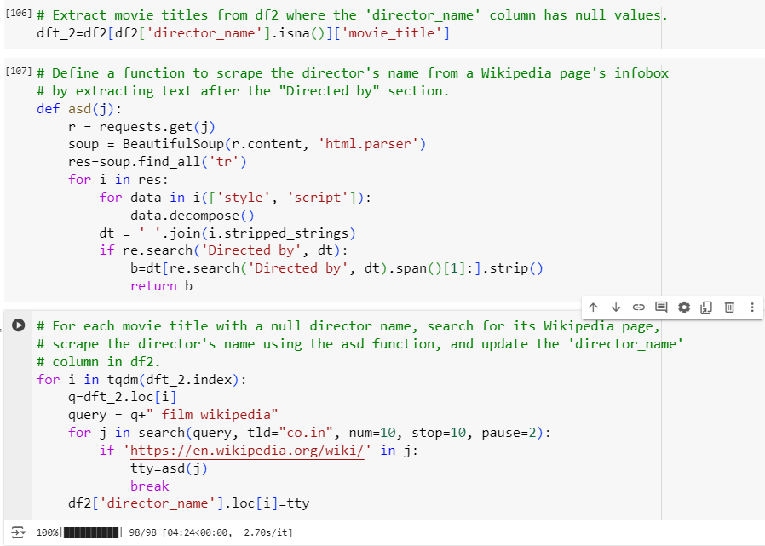
DATA PRE-PROCESSING
12 a. Addressing Null values in the 'director_name' column. To tackle this, we extract rows with missing director names, scrape each movie's Wikipedia page to retrieve the director's name, and then update the original dataframe with this information.

Slide 26
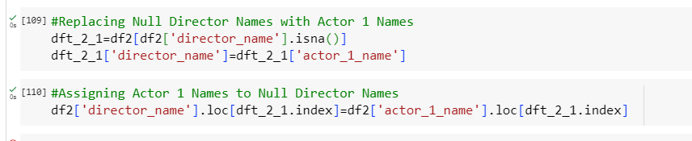
DATA PRE-PROCESSING
12 b. To handle Null values in the 'director_name' column that were not addressed in the previous step, we replace them with the 'actor_name_1' values of the respective movie.

Slide 27
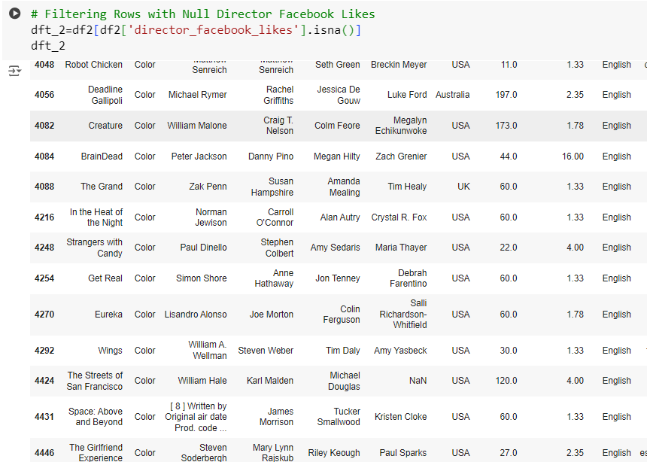
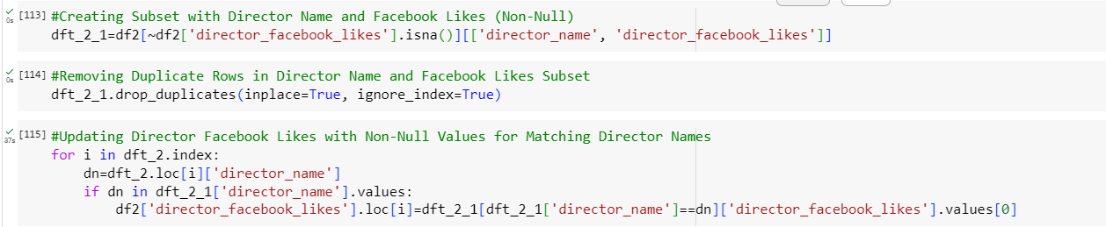
DATA PRE-PROCESSING
13a. To address Null values in the 'director_facebook_likes' column, we search for the director's Facebook likes within the dataset and use these values to fill in the missing director_facebook_likes entries.

Slide 28
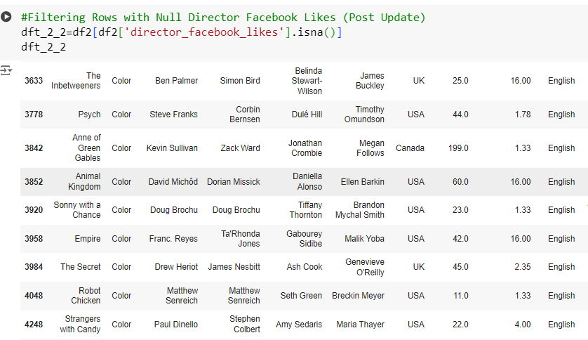
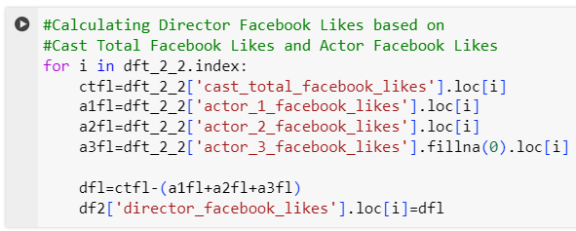
DATA PRE-PROCESSING
13b. Null values in the 'director_facebook_likes' column that were not updated in the previous step. Here, we replace these Null values with the difference between the 'cast_total_facebook_likes' and the sum of 'actor_1_facebook_likes', 'actor_2_facebook_likes', and 'actor_3_facebook_likes' of the corresponding row.

Slide 29
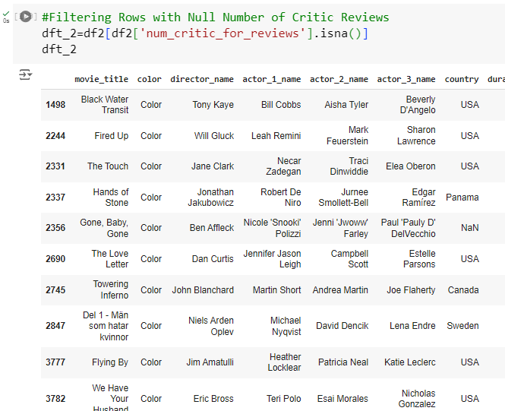

DATA PRE-PROCESSING
14. To address Null values in the 'num_critic_for_reviews' column, we simply replace these missing values with 0.

Slide 30
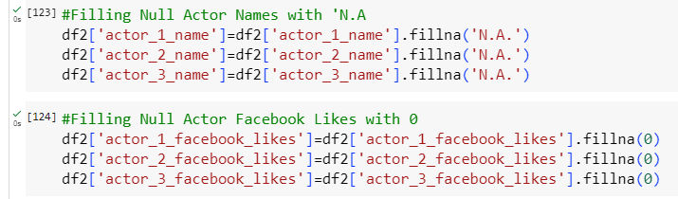
DATA PRE-PROCESSING
15. we handle Null values in the 'actor_1_name', 'actor_2_name', 'actor_3_name', 'actor_1_facebook_likes', 'actor_2_facebook_likes', and 'actor_3_facebook_likes' columns by replacing missing actor names with 'N.A.' and replacing Null values of actor Facebook likes with 0.

Slide 31

DATA PRE-PROCESSING
16. To address Null values in the 'color' column, we replace these missing values with 'Color,' which was identified through a manual check on the internet.

Slide 32
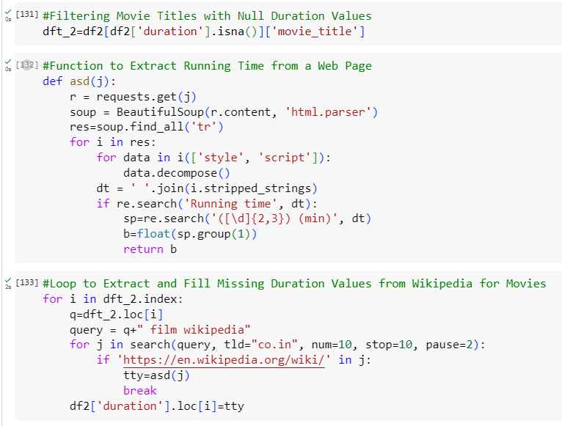
DATA PRE-PROCESSING
17a. To handle Null values in the 'duration' column, we extracted rows with missing durations and scraped each movie's Wikipedia page to retrieve the duration information. This data was then stored back in the original dataframe.

Slide 33
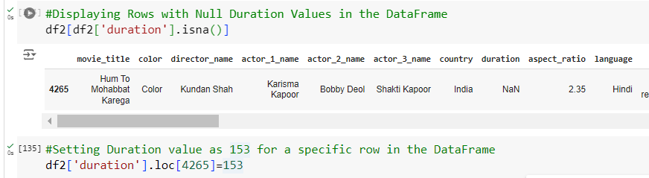
DATA PRE-PROCESSING
17b. To address Null values in the 'duration' column that were not updated in the previous step, we replace these missing values with duration information obtained through a manual check on the internet.

Slide 34
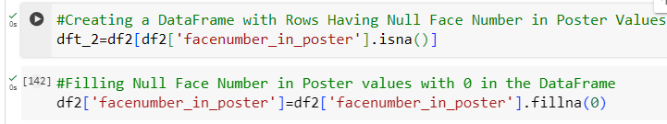
DATA PRE-PROCESSING
18. To handle Null values in the 'facenumber_in_poster' column, we replace the missing values with 0 after confirming this information through online sources.

Slide 35
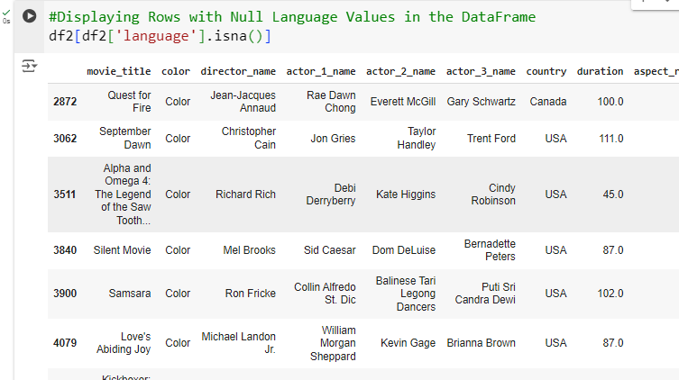

DATA PRE-PROCESSING
19. To address Null values in the 'language' column, we replace the missing values with 'English' after verifying this information through online sources.

Slide 36
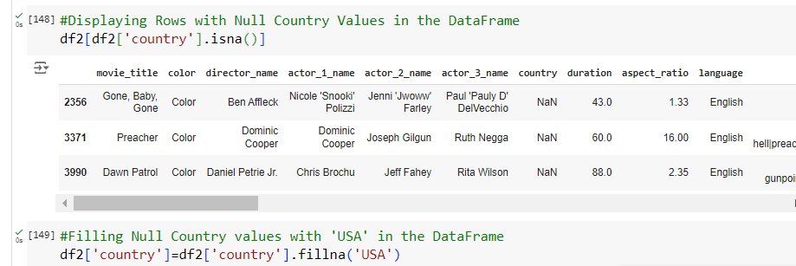
DATA PRE-PROCESSING
20. To handle Null values in the 'country' column, we replace the missing values with 'USA' after verifying this information through online sources

Slide 37
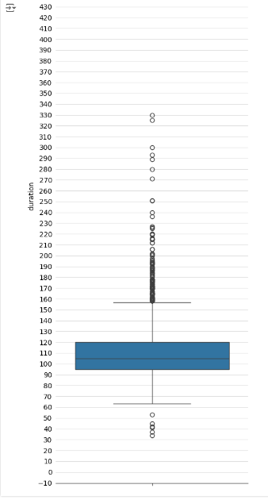
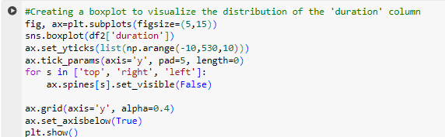
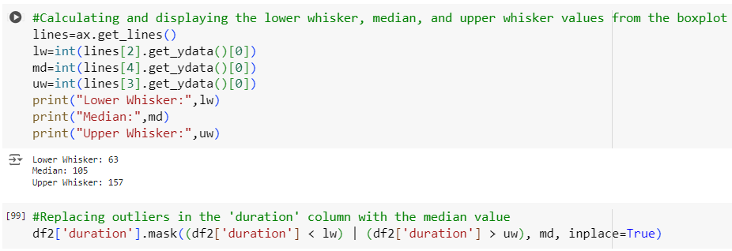
DATA PRE-PROCESSING
Outlier Detection
1. Handling outliers in the duration column by replacing values above and below the upper and lower whisker marks, respectively, with the median.

Slide 38
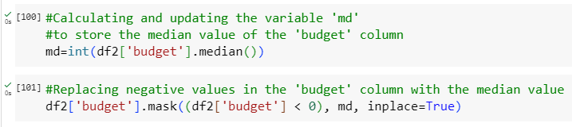
DATA PRE-PROCESSING
Outlier Detection
2. Addressing outliers in the budget column by replacing values less than 0 with the median value.

Slide 39
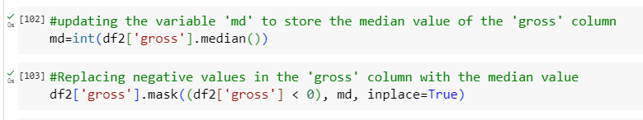
DATA PRE-PROCESSING
Outlier Detection
3. Managing outliers in the gross column by replacing values less than 0 with the median value.

Slide 40
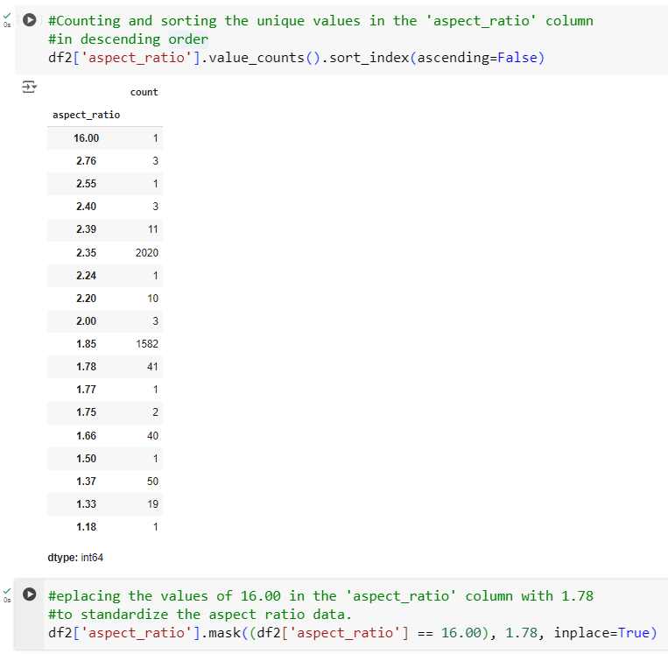
DATA PRE-PROCESSING
Handling errors
1. Handling Errors in the aspect_ratio Column: It appears that the value 16.00 may be an error, likely representing a ratio of 16/9. Therefore, all instances of 16.00 in the aspect_ratio column have been replaced with 1.78 (16/9).

Slide 41
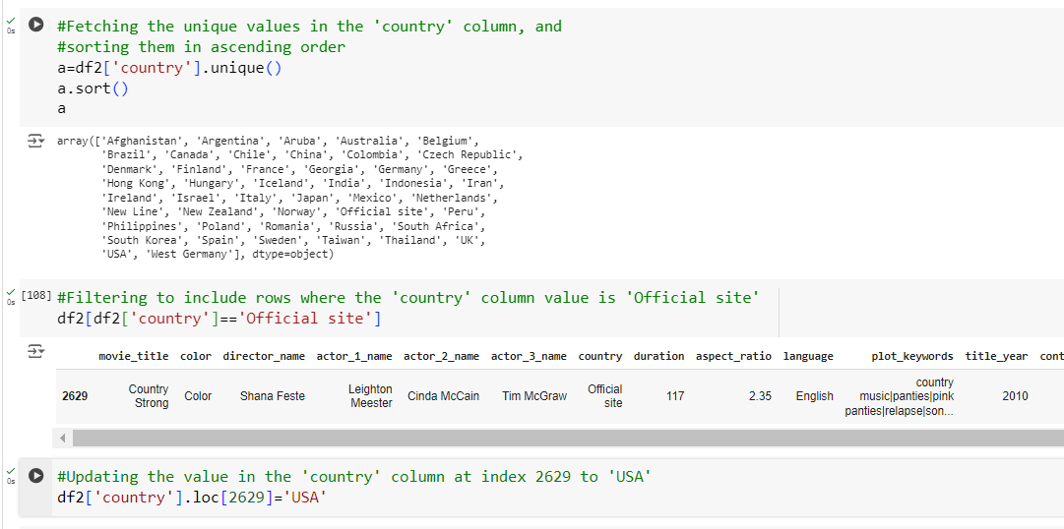
DATA PRE-PROCESSING
Handling errors
2. Addressing Errors in the Country Column: Upon manual verification on the internet, it appears that 'Official site' is an error. We have replaced it with 'USA' for accuracy

Slide 42
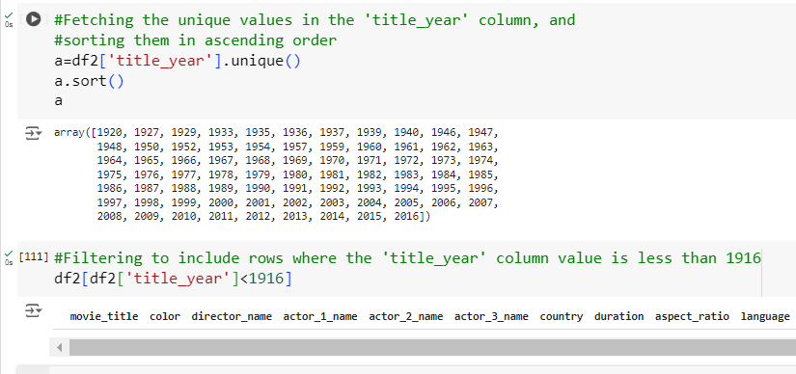
DATA PRE-PROCESSING
Handling errors
3. Handling Outliers in the title_year Column: Values less than 1916 are considered outliers. As no data below 1916 was found, these values have been retained as they are.

Slide 43
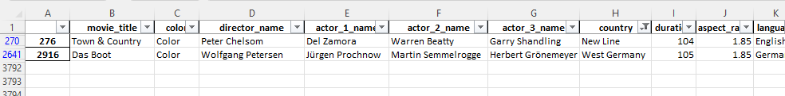
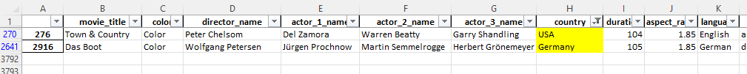
DATA PRE-PROCESSING
Handling errors
4. Country column – Replaced ‘New Line’ with USA, and ‘West Germany’ with Germany.

Slide 44
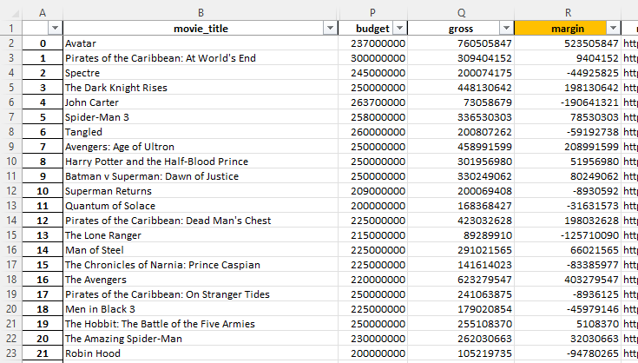
DATA PRE-PROCESSING
Feature engineering
1. Implemented feature engineering by creating a new column named 'margin' that represents the difference between the values in the 'gross' and 'budget' columns.

Slide 45

DATA PRE-PROCESSING
Feature engineering
2. Conducted feature engineering on the 'plot_keywords' column by splitting the keywords using '|' as a separator, and subsequently removed the original 'plot_keywords' column for data refinement.

Slide 46

DATA PRE-PROCESSING
Feature engineering
3. Implemented feature engineering on the 'genres' column by splitting the genres using a pipe '|' separator and subsequently removed the original 'genres' column for data refinement.

Slide 47

DATA PRE-PROCESSING
Feature engineering
4. Conducted feature engineering on the 'genres' column by introducing a new column named 'genre_no' to capture the count of genres associated with each row.

Slide 48

DATA ANALYTICS TASKS
A. Movie Genre Analysis: Analyze the distribution of movie genres and their influence on IMDB scores by identifying the most prevalent genres in the dataset and computing descriptive statistics (mean, median, mode, range, variance, standard deviation) of the IMDB scores for each genre.
Top 10 most common genres are : Drama, Comedy, Thriller, Action, Romance, Adventure, Crime, Sci-Fi, Fantasy, Horror

Slide 49

DATA ANALYTICS TASKS
A. Movie Genre Analysis: Analyze the distribution of movie genres and their influence on IMDB scores by identifying the most prevalent genres in the dataset and computing descriptive statistics (mean, median, mode, range, variance, standard deviation) of the IMDB scores for each genre.
Horror has the widest range of scores: With the highest range (7.40), Horror shows the greatest variability in IMDB ratings, indicating that it has both highly rated and poorly rated films.
Thriller and Crime have the highest max scores: Both genres reach the highest IMDB score of 9.30, reflecting the presence of some extremely well-rated films in these categories.
Comedy has the lowest mean score: Comedy films have the lowest average IMDB score (6.43), suggesting that, on average, they may not be as highly rated as other genres.

Slide 50


DATA ANALYTICS TASKS
B. Movie Duration Analysis: Analyze the distribution of movie durations and explore the correlation between movie duration and IMDB score to understand their impact on movie ratings.

Slide 51
DATA ANALYTICS TASKS
B. Movie Duration Analysis: Analyze the distribution of movie durations and explore the correlation between movie duration and IMDB score to understand their impact on movie ratings.
Slight positive correlation: There is a slight upward trend, indicating that longer movies tend to have marginally higher IMDB scores, though the correlation is not very strong.
Most movies are clustered around 90-120 minutes: The majority of the films fall in the range of 90 to 120 minutes in duration, with IMDB scores generally between 6 and 8.
Outliers exist for both short and long durations: A few shorter movies (below 60 minutes) and longer movies (above 160 minutes) are present, but they do not consistently follow the trend, showing both high and low IMDB scores.

Slide 52

DATA ANALYTICS TASKS
C. Language Analysis: Investigate the distribution of movies across various languages, identify the predominant languages used, and assess their impact on the IMDB score through descriptive statistics analysis.
The plot show that English is the most common language used in movies followed by French, Spanish, Hindi and Mandarin

Slide 53

DATA ANALYTICS TASKS
C. Language Analysis: Investigate the distribution of movies across various languages, identify the predominant languages used, and assess their impact on the IMDB score through descriptive statistics analysis.
Mandarin films perform best: With the highest mean (7.60) and mode (7.60), Mandarin films have the strongest average IMDB ratings compared to the other languages.
English films show the most variability: English has the highest variance (1.11) and standard deviation (1.05), indicating a wider range in film quality, with more varied IMDB scores.
Spanish films are the most consistent: Spanish films have zero variance and standard deviation, suggesting a very consistent performance across IMDB ratings, though they lack a clear mode.

Slide 54

DATA ANALYTICS TASKS
D. Director Analysis: Exploring the influence of directors on movie ratings. Task: Identify top directors based on their average IMDB score and analyze their contribution to the success of movies using percentile calculations.
Top 10 directors are identified based on their movie count and high percentile value.

Slide 55

DATA ANALYTICS TASKS
D. Director Analysis: Exploring the influence of directors on movie ratings. Task: Identify top directors based on their average IMDB score and analyze their contribution to the success of movies using percentile calculations.
Top Directors by IMDb Rating: Peter Jackson has the highest average IMDb rating of 7.89 among top directors, indicating strong overall performance.
Directors with the Most Movies: Peter Jackson and Andrew Stanton both have the highest movie counts (25 each), suggesting they have a larger body of work, which might contribute to their high average ratings.
Directors in the Highest Percentile: Peter Jackson and Morten Tyldum are in the 97th percentile for IMDb ratings, reflecting their exceptional performance compared to other directors.

Slide 56

DATA ANALYTICS TASKS
E. Budget Analysis: Investigating the correlation between movie budgets and financial success. Task: Analyzing the relationship between movie budgets and gross earnings, and identifying films with the highest profit margins.
The movie Avatar has the highest profit margin, followed by Jurassic World and Titanic.

Slide 57


DATA ANALYTICS TASKS
E. Budget Analysis: Investigating the correlation between movie budgets and financial success. Task: Analyzing the relationship between movie budgets and gross earnings, and identifying films with the highest profit margins.

Slide 58
RESULT
Insightful Analysis:
Factors Influencing Ratings and Performance: Through this project, we gained valuable insights into factors such as genres, durations, languages, directors, and budgets. By analysing these elements, we identified trends and patterns that shed light on audience preferences and industry dynamics.
Our findings offer actionable insights for filmmakers, producers, and studios to optimize movie production strategies and enhance audience appeal.
Understanding Data Analytics in Movie Analysis:
Relationships and Decision-Making: The project emphasized the importance of data analytics in movie analysis. It provided a deeper understanding of how factors like director influence, genre impact, and budget allocation relate to IMDB scores.
These insights support data-driven decision-making processes in the film industry.

Slide 59
RESULT
Hands-On Experience:
Data Preprocessing and Communication: I gained hands-on experience in data preprocessing tasks, including cleaning, handling outliers, and feature engineering.
Additionally, I developed skills in communicating insights effectively to stakeholders, enabling informed decisions based on the analysis.
Skill Development:
Tools and Techniques: The project enhanced my proficiency in MS Excel and Python, expanding my understanding of their functionalities and applications in data analysis.
This experience has equipped me with the skills needed to analyse complex datasets and derive meaningful insights.

Slide 60
THANK YOU

